Slide 1
Network Management Information model
Zeinab MOVAHEDI

Slide 2
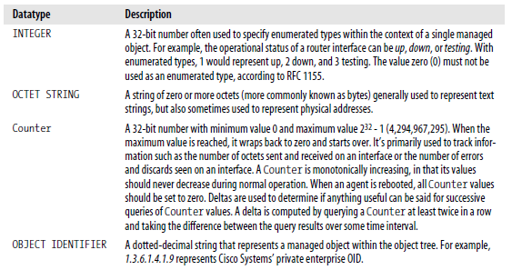
SMI I data types

Slide 3
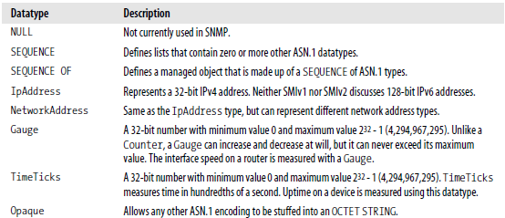
SMI I data types

Slide 4
Subtypes
subtype will limit the set of allowed values to only a subset of the allowed values of the parent type.
OddSingleDigitPrimes ::= INTEGER ( 3 | 5 | 7 )
SingleDigitPrimes ::= INTEGER ( 2 | INCLUDES OddSingleDigitPrimes)
PositiveNumber ::= INTEGER ( 1 .. MAX)
Month ::= (1 .. 12)
Month ::= (1 .. <13)

Slide 5
Exemples
What is the difference between these 3 declarations?
① Characteristics ::= BIT STRING {gender(0), adult(1), blueEyed(2), caucasian(3) }
② Characteristics ::= BIT STRING {gender(0), adult(1), blueEyed(2), caucasian(3) }(SIZE (0 .. 4))
③ Characteristics ::= BIT STRING {gender(0), adult(1), blueEyed(2), caucasian(3) }(SIZE (4))

Slide 6
Exemple
A store holds paper in the formats A3, A4, A5 and A6. A user wants to know if sheets are available in each of these four formats. Specify a data type to report this to the user.
Solution:
InStore ::= BIT STRING {
a3 (0),
a4 (1),
a5 (2),
a6 (3)
} (SIZE(4))

Slide 7
Exercice
What is the difference between these two types, and what does Monday mean for each of them?
DayOfTheWeek ::= ENUMERATED { monday(0), tuesday(1), wednesday(2), thursday(3), friday(4), saturday(5), sunday(6) }
DaysOpen ::= BIT STRING { monday(0), tuesday(1), wednesday(2), thursday(3), friday(4), saturday(5), sunday(6) } (SIZE(7))
Solution: DayOfTheWeek can have as value one of the seven days, and the value monday designates that single day. DaysOpen can have as value a bit string, which specifies for each day, whether a shop is open or not on that day. monday is the name of the first bit, which is true if the shop is open on mondays, and false if it is closed on mondays.

Slide 8
Exemple
In an opinion poll, made at the exit door from the election rooms, every voter is asked to indicate which party they voted for. Allowed values are Labour, Liberals, Conservatives or other. The age of each voter is also registered as a positive integer above the voting age of 18 years, and the gender is registered. Define a data type to transfer this information from the poll station to a server.
Solution:
Voter ::= SEQUENCE {
vote Vote,
age Age,
gender Gender
}
Age ::= INTEGER ( 18 .. MAX )
Gender ::= BOOLEAN
Vote ::= INTEGER {
labour(0),
liberals (1),
conservatives (2),
other (3)
} (0 .. 3)

Slide 9
Structure of Management Information (SMI)
An object possesses:
A name (Descriptor + Object identifier)
A syntaxe based on ASN.1 (Abstract Syntaxe Notation)
A definition which is a textual description of the semantics of object type
An access mode specifying the access privilege to that object (read only, read-write or not accessibe)
A status which specifies if the object is current (mondatory ou optional) ou obsolete.
A BER (Basic Encoding Rules) coding scheme

Slide 10
Structure of Management Information (SMI)
The characteristics of an object are grouped in the definition of a macro that defines the structure of an object type:
OBJECT-TYPE MACRO ::=
BEGIN
TYPE NOTATION ::=
"SYNTAX" type (TYPE ObjectSyntax)
"ACCESS" Access
"STATUS" Status
VALUE NOTATION ::= value (VALUE ObjectName)
Access ::= "read-only"
|"read-write"
|"write-only"
|"not-accessible“
Status ::= "mandatory"
|"optional"
|"obsolete"
|"deprecated"
END

Slide 11
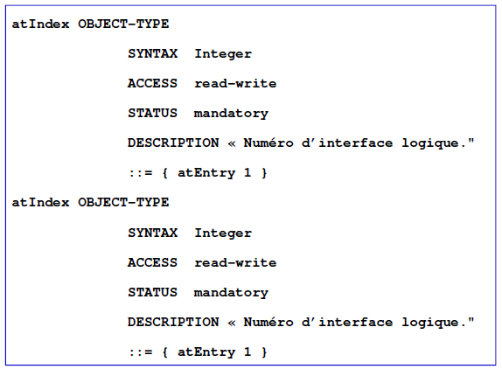
Structure of Management Information (SMI)

Slide 12
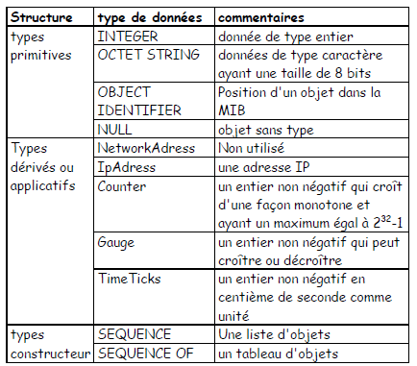
Structure of Management Information (SMI)
The structure of ASN.1 data types for SNMP:

Slide 13
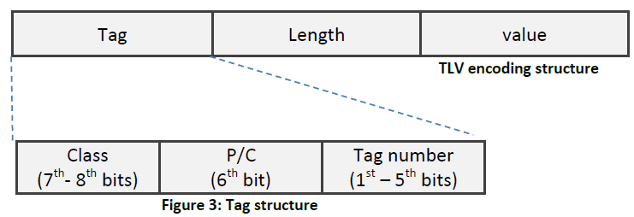
BER Encoding Rules
The ASN.1 syntax written in text format is encoded using BER to make the binary information to be transferred between the Manager and Agent.
BER is based on the tag-length-value.

Slide 14
BER Encoding rules
Class:
Universal - always true (00)
Application - only in the application used (01)
Context-specific - specific context in application (10)
Private - used extensively by commercial vendors (11)
P/C: designate a type
primitive (0)
constructed (1)
Tag number: is a number or code specified for a type.

Slide 15
BER Encoding rules
0 <= tag number <= 30 (One-Octet-Variant)
Tag number contains one element and it is encoded in the remaining 5 bits
Tag number > 30 (Multiple-Octet-Variant)
Remaining five bits are all 1-s
Tag number value is encoded in the last 7 bits of one or more succeeding octets. The first bit of each such succeeding octet is 1 for all octet except the last octet.

Slide 16
Table 3.5. Universal Class Tag Assignments
Tag | Type Name | Set of Values
Universal 1 | BOOLEAN | TRUE or FALSE
Universal 2 | INTEGER | 0, Positive and negative numbers
Universal 3 | BIT STRING | A string of binary digits or null set
Universal 4 | OCTET STRING | A string of octets or null set
Universal 5 | NULL | Null, single-valued
Universal 6 | OBJECT IDENTIFIER | Set of values associated with the object
Universal 7 | Object description | Human readable text describing the object
Universal 8 | EXTERNAL | The type is external to the standard
Universal 9 | REAL | Real numbers, expressed in scientific notation Mantissa × Base^{exponent}
Universal 10 | ENUMERATED | Specified list of integers
Universal 11 | ENCRYPTED | Encrypted information
Universal 12–15 | Reserved for future use
Universal 16 | SEQUENCE and SEQUENCE OF | Ordered list of types
Universal 17 | SET and SET OF | Unordered list of types
Universal 18 | NumericString | Digits 0–9, space
Universal 19 | PrintableString | Printable characters
Universal 20 | TeletexString | Character set specified by CCITT Recommendation T.61
Universal 21 | VideotexString | Character set specified by CCITT Recommendation T.100 and T.101
Universal 22 | IA5String | International Alphabet 5, which is equivalent to ASCII
Universal 23 | UTCTime | Time format YYMMDDHHMM[SS][local time differential from universal standard time]
Universal 24 | GeneralizedTime | Time format YYYYMMDDHHMM[SS][local time differential from universal standard time]
Universal 25 | GraphicString | Graphic character set specified by ISO 8824
Universal 26 | VisibleString | Character set specified by ISO 646, equivalent to ASCII
Universal 27 | GeneralString | General character string
Universal 28 | CharacterString | Character set
Universal 29– | Reserved for future use

Slide 17
BER encoding - examples
Example 1
OCTET STRING is a primitive and universal type, with a tag value of 4 (type = 00000100)
Example 2
INTEGER is a primitive and universal type, with a tag value of 2 (type = 00000010)

Slide 18
BER Encoding - exemple
Length field specifies the length of value field in number of octets
Short or one-octet form (0 <= length value <= 127)
Most significant bit is set to 0
Remaining 7 bits indicating the length of the value
Long or multiple-octet form (length value > 127)
Most significant bit is set to 1
Remaining 7 bits of the first octet indicates how many octets follow to specify the length
The length is then encoded as a binary number in the rest of octets.

Slide 19
Example
Example 1
Length = 128
Length is encoded as 10000001 10000000
Example 2
What is the BER encoding of octet string of «0C1B»H (in hexadecimal)
00000100 00000010 00001100 00011011

Slide 20
Encoding rules – tagged values
Default tag (universal tag)
Explicit tag
Add the new tag in front of the existing tag.
B ::= [2] EXPLICIT INTEGER
Implicit tag
Replace the existing tag by the new one.
B ::= [2] IMPLICIT INTEGER

Slide 21
Encoding rules – tagged values examples
B ::= [2] EXPLICIT INTEGER
b B ::= 260
B ::= [20] IMPLICIT INTEGER
b B ::= 117
C ::= OCTET STRING
c C ::= « FRED »
C ::= [7] OCTET STRING
c C ::= « FRED »
C ::= [7] EXPLICIT OCTET STRING
c C ::= « FRED »
C ::= [7] IMPLICIT OCTET STRING
c C ::= « FRED »

Slide 22
BER Encoding Rules Constructed type
The value of a constructed type is itself split into a series of TLV objects.

Slide 23
BER Encoding Rules Constructed type
Given the ASN.1 definition. Show its coding in BER.
Surname ::= [APPLICATION 1] IA5String
hername Surname ::= "Mary“
Given the ASN.1 definitions below. Give a BER encoding of this value.
Light ::= ENUMERATED {
dark (0),
parkingLight (1),
halfLight (2),
fullLight (3) }
daylight Light ::= halflight

Slide 24
BER Encoding Rules Constructed type
You are to define a protocol for communication between an automatic scale and a packing machine. The scale measures the weight in grams as a floating point number and the code number of the merchandise as an integer. Define a data type ScaleReading which the scale can use to report this to the packing machine.
Some countries use, as an alternative to the metric system, a measurement system based on inches, feet and yeards. Define a data type Measurement which gives one value in this system, and Box which gives the height, length and width of an object in this measurement system. Feet and yards are integers, inches is a decimal value (=floating point value with the base 10).

Slide 25
BER encoding – object identifier
Z0.Z1…..Zn
Object identifier: universal 6, primitive
Z0 and Z1 are both encoded on a single octet: Z0*40+Z1
To reduce the size of value, the first and second part of value is merged together.
Other Zi are each encoded on a separate octet if Zi>127
BER encoding of an object with object identifier of 1.3.6.1 is
00000110 00000011 00101011 00000110 00000001

